Slide 1




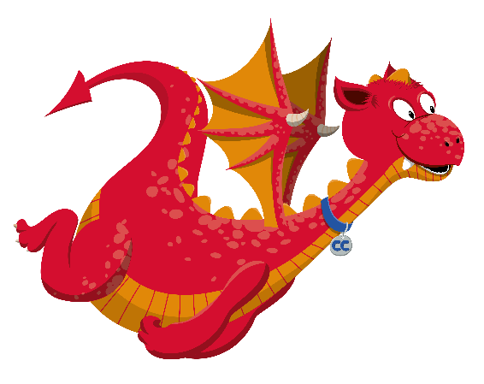



Cymraeg Pob Dydd
yn y Cartref
An introduction to Everyday Welsh
for parents / guardians
This presentation is intended for non- Welsh speaking parents / guardians who wish to familiarise themselves with the Cymraeg Pob Dydd / Everyday Welsh used in school. The presentation contains audio content to exemplify correct pronunciation for any parents wishing to use some basic Welsh with their children at home.

Slide 2
Helo a da bo!
Saying ‘hello’
and ‘goodbye’

Slide 3

Helo a da bo!
Helo – Hello
Shwmae?- How are things?
Bore da - Good morning
Prynhawn da - Good afternoon
Nos da – Good night
Hwyl – Bye / cheerio
Hwyl fawr - Goodbye
Da bo – Goodbye
Gwela i di – See you (1 child)
Gwela i chi – See you ( 2 children+)

Slide 4
Sut wyt ti?
Other greetings

Slide 5
Sut wyt ti?
Sut wyt ti?- How are you? (one child)
Sut ydych chi? – How are you? (two children +)
Your child might say: You might say:
Hapus - happy Da iawn – very well
Wedi blino – tired Da iawn diolch – very well thank-you
Yn grac – angry Iawn – fine
Bendigedig – wonderful Gweddol – fair /so-so
Ofnadwy- awful Grêt diolch – great thank-you
Ar ben y byd – on top of Wedi danto! – fed up!
the world

Slide 6
Diolch!
Courtesy

Slide 7
Diolch!
Diolch - thanks / thank-you
Diolch yn fawr – thank-you very much
Dim diolch – no thank-you
Croeso – you’re welcome
Plîs – please
Os gwelwch yn dda – please
Esgusodwch fi – excuse me

Slide 8
Beth sy’n bod?
Illness

Slide 9
Beth sy’n bod?
Beth sy’n bod? – What’s the matter?
Wyt ti’n dost? – Are you unwell / ill?
Pen tost – head ache
Bola tost – stomach ache
Clustiau tost - earache
Annwyd - cold
Y ffliw - flu
Dim ysgol heddiw!– no school today!

Slide 10
Mae hi’n amser..
It’s time for..

Slide 11
Mae hi’n amser..
Mae hi’n amser…- It is time for…..
..brecwast – breakfast
..cinio - lunch
..te - tea
..swper – supper
..snac – snack
..ysgol - school
..gwaith cartref - homework
..golchi dwylo – wash hands
..brwsio dannedd – clean teeth
..stori / darllen – a story / to read
. gwely - bed

Slide 12
Sut mae’r tywydd?
Discussing the
weather

Slide 13
Sut mae’r tywydd?
Sut mae’r tywydd? – What is the weather like?
Sut mae’r tywydd heddiw? – What is the weather like today?
Mae hi’n…- It is..
..braf – fine
..heulog - sunny
..oer - cold
..wyntog - windy
..gymylog - cloudy
..bwrw glaw - raining
..bwrw eira -snowing
.

Slide 14
Gwisgwch eich cot!
Dressing for the
weather

Slide 15
Gwisgwch eich cot!
Mae hi’n bwrw glaw – It is raining
Mae hi’n oer – It is cold
Gwisga dy got – Put on your coat (1child)
Gwisgwch eich cotiau – Put on your coats (2 children+)
Mae hi’n heulog – It is sunny
Mae hi’n braf – It is fine
Tynna dy got- take off your coat (1 child)
Tynnwch eich cotiau – Take off your coats (2 children +)

Slide 16
Sawl un sy yma?
Number

Slide 17
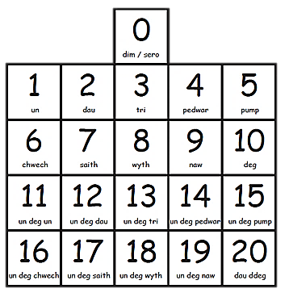
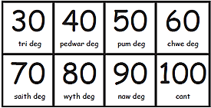
Sawl un sy yma?
Sawl un? – How many?
Sawl un sy yma? – How many are here?

Slide 18
Pa liw ydy hwn?
Colour

Slide 19


Pa liw ydy hwn?
coch
melyn
glas
gwyrdd
oren
porffor
du
gwyn
brown
pinc
llwyd
Pa liw ydy hwn? – What colour is this?

Slide 20
Ga i helpu?
Helping

Slide 21
Ga i helpu?
Beth sy’n bod? – What’s the matter?
Oes problem? – Is there a problem?
Popeth yn iawn? – Everything ok?
Ga i helpu? – May I help?
Dyma ti – Here you are (one child)
Dyma chi – Here you are (2 children+)
Croeso – You’re welcome

Slide 22
Da iawn ti!
Praise

Slide 23
Da iawn ti!
Da iawn – Well done
Bendigedig - Wonderful
Ffantastig - Fantastic
Gwych - Great
Da iawn ti! – Well done you!
Gwaith cartref da – Good homework
Darllen da – Good reading

Slide 24
Dim problem!
Handy phrases

Slide 25
Dim problem!
Dim nawr – Not now
Dim eto – Not yet
Dim heddiw – Not today
Dim problem – No problem
Dim ots – It doesn’t matter
Popeth yn iawn- Everything is fine
Yn ofalus – Careful / carefully
Yn dawel - Quietly

Slide 26
Siaradwch yn Gymraeg!
Instructions

Slide 27
Siaradwch yn Gymraeg!
One child 2 children +
Gwranda – Listen Gwrandewch – Listen
Stopia – Stop Stopiwch - Stop
Dere ’ma – Come here Dewch yma – Come here
Cofia – Remember Cofiwch - Remember

