Slide 1

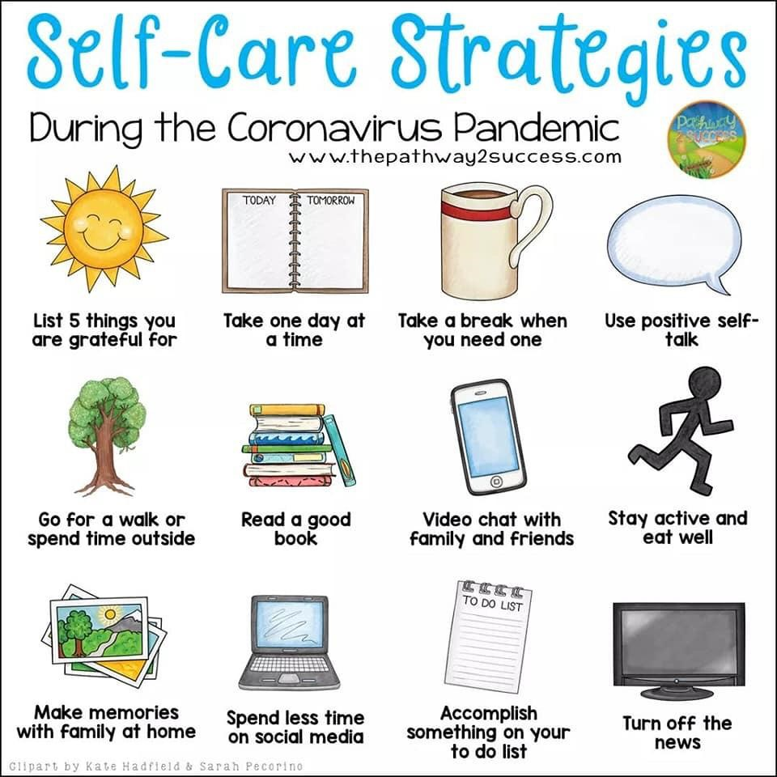
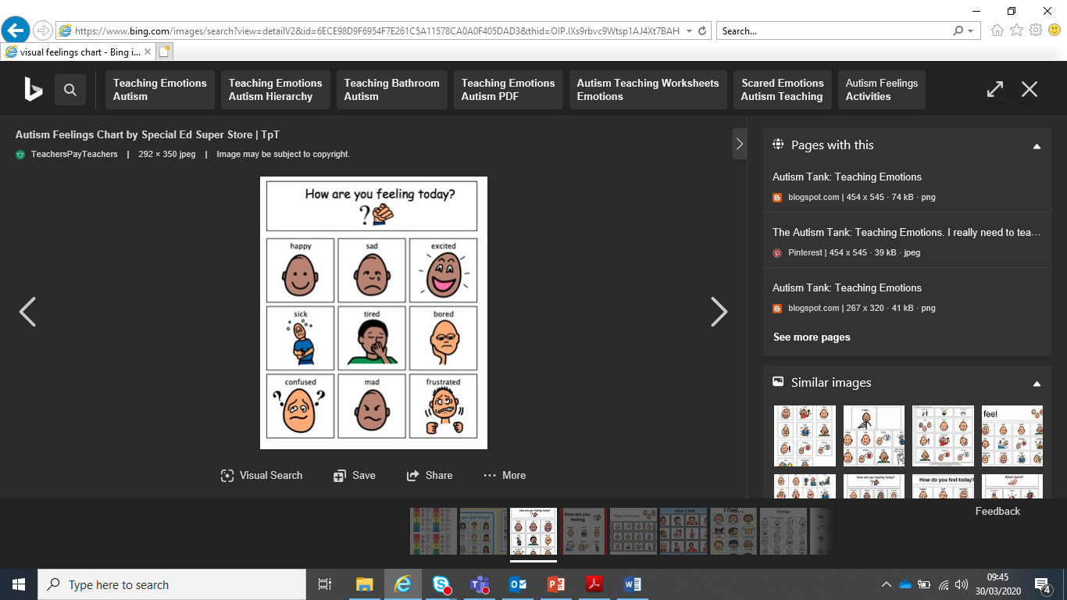
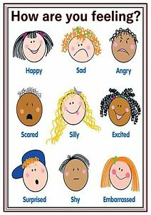
Top Tips for Supporting Children with
Complex & Specific Difficulties
Dear Parent / Carer,
I hope that you are keeping well and safe during this difficult time. Please find below a ‘Top Tips’ handout that you may find useful aimed at supporting parents and pupils across Swansea on my caseload whilst schools are closed. There are a range of useful strategies, links, activities and resources to support your child’s needs. However, your families health and wellbeing are more important than anything else. You are not expected to be your child’s teacher – please concentrate on your own and your child’s health and happiness whilst taking information from this handout which may be helpful, meaningful and relevant to your child.
We will get through this difficult period and are all in it together. Please take care and stay safe. I am due to start maternity leave in May - It is a pleasure supporting your child and I look forward to working with your child again following my maternity leave when we get through this time of uncertainty.
Lyndsay Jenkins
Teacher for Pupils with Complex and Specific Difficulties/Physical and Complex Difficulties). Lyndsay.Jenkins@swansea.gov.uk
Emotional Wellbeing
Your child’s emotional wellbeing is paramount – Especially at this difficult time. Enjoy spending time as a family, talking, laughing, looking at books together, watching films together and playing together. Focus on being together as a family providing reassurance and security at this unsettling time for your child.
Your emotional wellbeing is also paramount - Self-care is important. These are difficult, unpredictable and ever changing times – it is important to look after yourselves. Children are aware of their parents anxieties and this can lead the children to feel anxious as well.

Slide 2
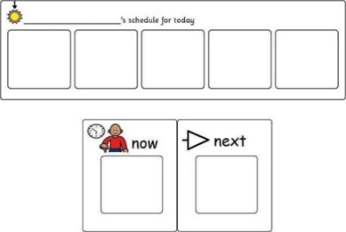
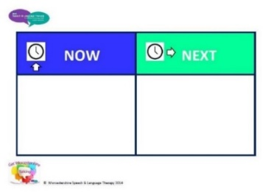
Top Tips
Play is absolutely vital to a child's healthy development - A child's exposure to play provides physical, intellectual, creative, emotional and social development. Play together with your child but make sure to allow time for free play also.
Routines are important – Children (as well as adults) tend to respond positively to knowing what is expected of them and having a structure to follow. Try to have a basic structure for each day and communicate this to your child in a way that in meaningful and relevant to them. This may help reduce anxiety levels. You know your child best and you know what may work best for them – do not overload or overstimulate your child. Start small (e.g. a clear wake up, bedtime and meal time routine) and then build on this when you see what works for your child during these uncertain times.
Visual clues/timetables – Your child may benefit from having a visual clue to what is expected of them and what to anticipate. This visual clue may be an object, photograph or symbol of what activity will happen next (whichever clue your child would understand). Don’t put too many things on a timetable if your child isn't ready for this. A ‘now and next’ board may be beneficial to use with your child if they are not ready to use a longer visual timetable to concentrate on what is happening now and then what will happen next.
Follow your child’s lead - if children are interested and motivated then they will learn a lot more naturally. Use your child's likes to create fun and meaningful activities.
Encouraging independence – Without having to rush to get the children ready for school, now is an ideal time to develop your child’s self-help and independence skills by giving them time to learn through experimentation and practice.
Encouraging life skills - Encourage your child to help with jobs around the house. Children learn best when they take part in real life experiences, e.g. helping pour a drink, making food, recycling, hoovering, cleaning, making their beds, putting their clothes away, helping with the laundry, etc. Photographs/drawings of what should be in each drawer may help.
Fun, meaningful and relevant activities – You are not expected to be your child’s teacher. Your child’s school will provide some activities, however your child may find these tasks difficult to do within their own home without their teacher/TA present. There are lots of ideas of what your child could do online and from school, but please do not feel overwhelmed by them all or feel that they all have to be completed. Every child is different and every situation is different. Keep activities short, stimulating and enjoyable.
Sensory play and exploration – Provide your child opportunities to learn through hands on sensory exploration to stimulate their senses. This will support language development, cognitive skills, fine and gross motor skills, problem solving skills, and social interaction as well as be a fun activity to do together! Ideas may included exploring with rice/icing sugar/water in bowls/pots/pans with hands/a wooden spoon.

Slide 3
Useful links:
Wellbeing:
Daily mindfulness activities may be beneficial for you and your child to do. Focus on what you can control and not what you cannot control. Look after yourself. Free mindfulness videos posted regularly to support you and your child - https://www.facebook.com/mindfulnesswithsoul
Mindfulness Video for children - https://www.youtube.com/watch?v=8OM9LtBWCgY
This website is to help adults with caring responsibilities look after the mental health and wellbeing of children or young people, including those with additional needs and disabilities, during the coronavirus (COVID-19) outbreak - https://www.gov.uk/government/publications/covid-19-guidance-on-supporting-children-and-young-peoples-mental-health-and-wellbeing/guidance-for-parents-and-carers-on-supporting-children-and-young-peoples-mental-health-and-wellbeing-during-the-coronavirus-covid-19-outbreak
Swansea Council Voluntary Service provide a list of links and advice for mental health and wellbeing support - https://www.scvs.org.uk/corona-virus-mental-health-well-being-information
Support with coping with Covid for children, young people and adults - https://childmind.org/coping-during-covid-19-resources-for-parents/
https://www.headspace.com/blog/2019/01/25/headspace-for-kids-meditations/
It is normal to feel a range of emotions during this crisis -https://www.who.int/docs/default-source/coronaviruse/coping-with-stress.pdf?sfvrsn=9845bc3a_2
Coronavirus Information for children/young people:
https://www.ldw.org.uk/project/coronavirus/
https://www.makaton.org/shop/shopping/freeDownloadDetails/Coronavirus-social-story
https://www.downs-syndrome.org.uk/coronavirus-covid-19/learning-at-home/
Examples of visuals clues/timetables:
Twinkl have currently made their ultimate pack free of charge using the code CVDTWINKLHELPS. Twinkl have a range of visual timetables as well as activities that children could do at home - https://www.twinkl.co.uk/
Widgit are offering a 21 day trial if you need/want to make symbols at home - https://widgitonline.com
School Closure Kit with a range of visuals - https://lisanallyspecialschool.co.uk/index.php/resources/general-resources/203-school-closure-toolkit-for-parents

Slide 4
Other Useful links:
Examples of activities to do at home:
Swansea Councils Play Team upload activities to encourage play regularly on their Facebook page - www.facebook.com/playonwheels
An extensive list of sensory activities, stories etc. - http://www.thesensoryprojects.co.uk/covid19-resources
A range of therapeutic activities to develop childrens fine motor skills, hand-eye co-ordination, self-help skills, upper body strength, sensory processing, pre-writing skills, writing skills, etc. - http://therapystreetforkids.com/
A range of free printable resources and ideas to support your childrens emotions at home during Covid19 - https://www.elsa-support.co.uk/category/free-resources/
Home activities for families with children with learning difficulties - https://contact.org.uk/news-and-blogs/entertaining-children-at-home/
Cardiff & Vale’s information pack to support children with learning difficulties during school closures - http://www.cardiffandvaleuhb.wales.nhs.uk/sitesplus/documents/1143/Supporting%20Children%20with%20LD%20&%20ASD%20with%20COVID%20Isolation.pdf
A range of social stories to read - https://www.abaresources.com/social-stories/
Free online course about multi-sensory learning - https://online.hirstwood.com/bundles/free-courses
A range of resources and ideas - http://www.priorywoods.middlesbrough.sch.uk/coronavirus/useful-resources
Supporting your child’s communication skills:
https://www.thecommunicationtrust.org.uk/resources/resources/resources-for-parents/
https://www.afasic.org.uk/resources/
https://www.icommunicatetherapy.com/wp-content/uploads/2012/09/The-importance-of-play-and-speech-and-language-development.pdf
https://www.afasic.org.uk/
www.ican.org.uk
https://chatterpack.net/blogs/blog/list-of-free-speech-language-communication-and-send-resources-for-schools-and-parent-carers
https://www.makaton.org/aboutMakaton/
Supporting children with Down’s Syndrome (these links may also be beneficial for learners with other learning difficulties):
https://www.downs-syndrome.org.uk/download-package/coronavirus-what-is-it-how-to-stay-safe-easy-read/
https://www.dseinternational.org/en-us/
https://www.seeandlearn.org/en-gb/
Support with personal/intimate care:
The Specialist Heath Visiting Team are on a rota within the office and are available if you have any questions about your child’s personal care (or difficulties with sleep) – 01639 862797.
Education & Resources for Improving Childhood Continence:
www.eric.org.uk 0845 3708008
Supporting people with bladder & bowel problems:
https://www.bbuk.org.uk 0161 6078219

